Slide 1
CAPSTONE PROJECT
SEGMENT 2
PREDICTING SEA ICE EXTENT USING MACHINE LEARNING
Group 2
Aryam Misgina
Leslie Debassige
Yu-Hsuan Lin
Amber Waqar NAUSHAHI

Slide 2
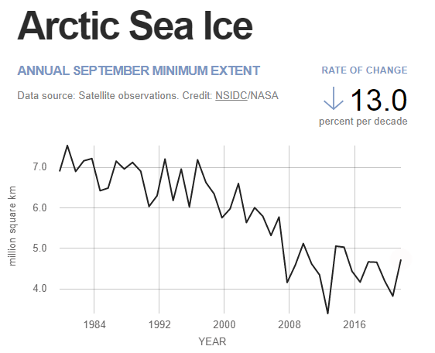
TOPIC SELECTED
Predicting sea-ice extent on the Arctic (north pole) using time series forecasting
Polar sea ice is a resource that impacts global climate change by regulating global temperature, affecting ocean currents and wildlife habitat.
As a region, the Arctic is showing more dramatic signs of climate change than any other part of the planet. These include a warming of air temperatures at a rate two to three times greater than the rest of the planet, and the loss of September sea ice extent at a rate of 13 percent per decade.

Slide 3
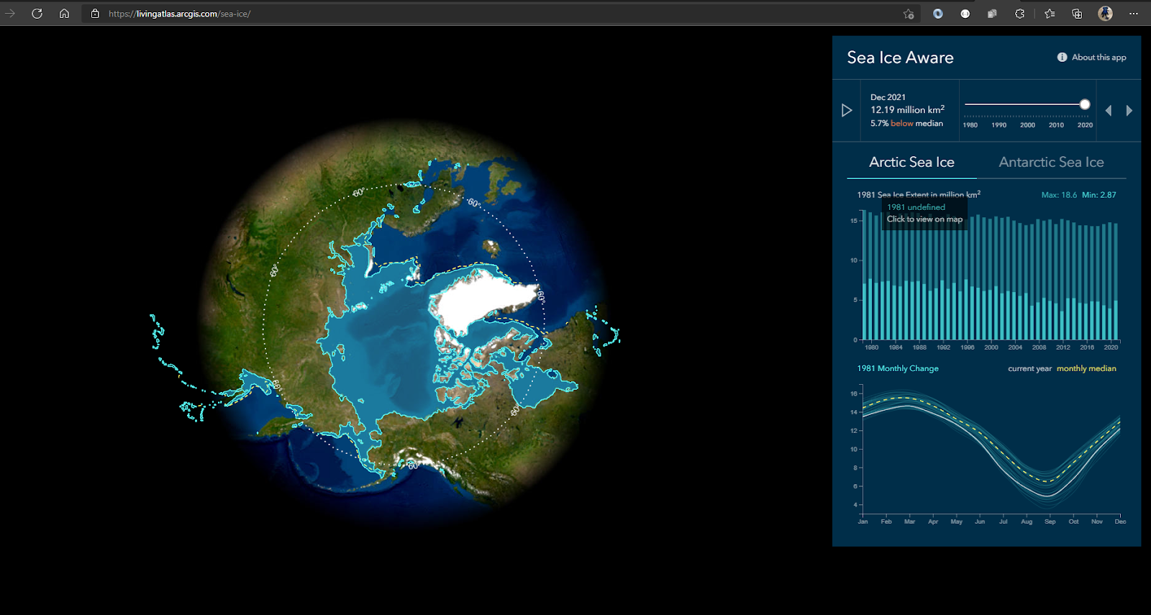
QUESTIONS WE HOPE TO ANSWER
Based on past trends, how will the sea-ice diminish in the future and what factors are contributing to it.

Slide 4











TECHNOLOGIES / TOOLS USED
ETL & Data Analysis Preprocessing
Building Algorithm
Databases
Machine Learning
Dashboard

Slide 5
SOURCE DATA
National Snow and Ice Data Center http://nsidc.org/data/
The daily Sea Ice Index provides a quick look at Arctic-wide changes in sea ice.
The daily Sea Ice Index provides a quick look at Antarctic-wide changes in sea
Visualize Arctic and Antarctic Sea Ice https://livingatlas.arcgis.com/sea-ice/
Climate Data Store https://cds.climate.copernicus.eu/cdsapp#!/search?type=dataset
2m Temperature (K)
Sea Ice Concentration(0 to 1)
Snow Albedo (0 to 1)
Snow Melt (m of water)
Surface Pressure (Pa)
Total Column Ozone (kg m2)
Extent (sq km)
Average Atmospheric Carbon di oxide mixing ratio (ppm
Average Atmospheric Methane mixing ratio (ppm)

Slide 6
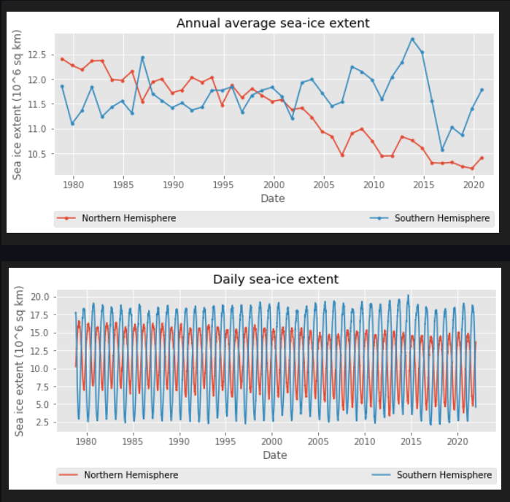
DATA EXPLORATION
We used R and pandas to determine the relationship between the target and features to assess correlation and evolution over time:
Sea ice sq km vs daily
Daily analysis of the amount per sq km of sea ice extent shown by the annual average polar sea-ice illustrates the extent of declining in both the Antarctic- southern region, and the Arctic- northern region of the globe.

Slide 7
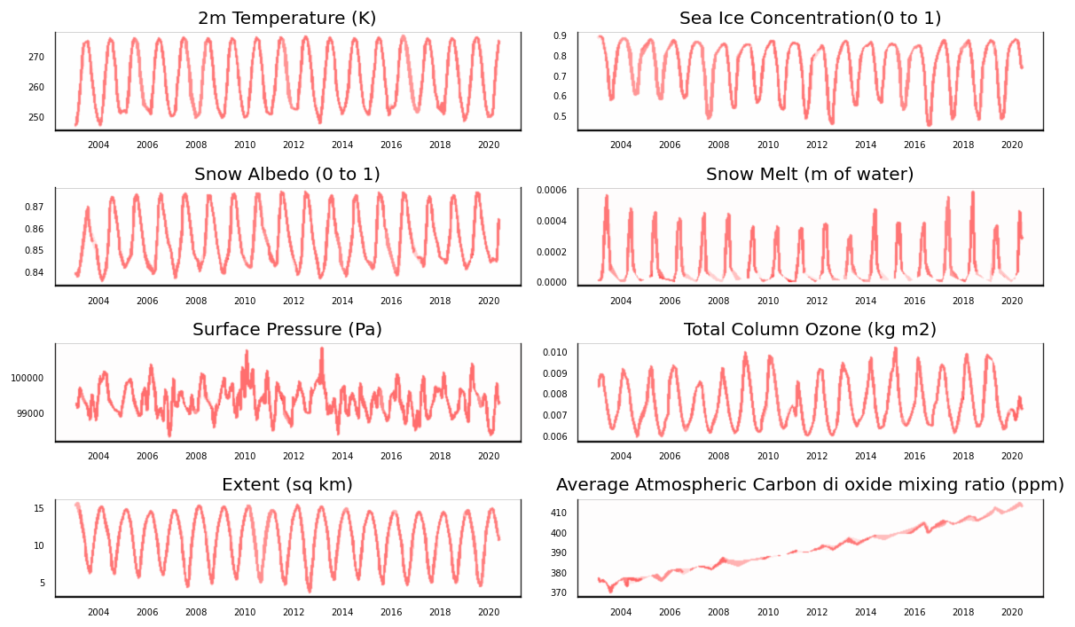
DATA EXPLORATION – 2003 - 2020

Slide 8
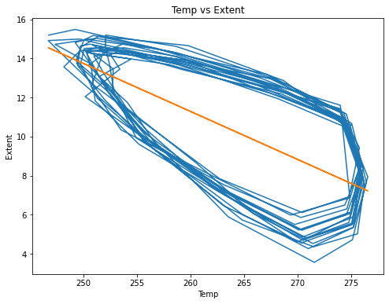
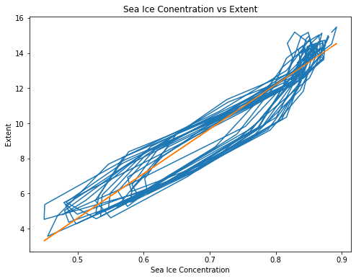
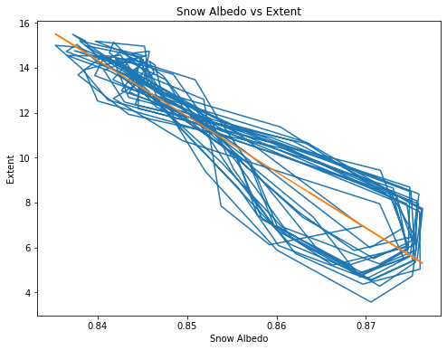
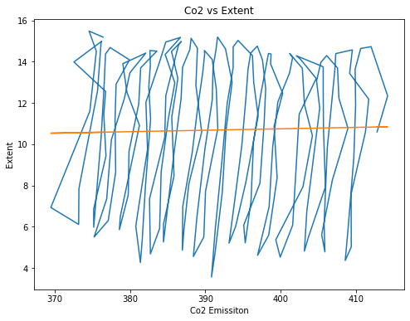
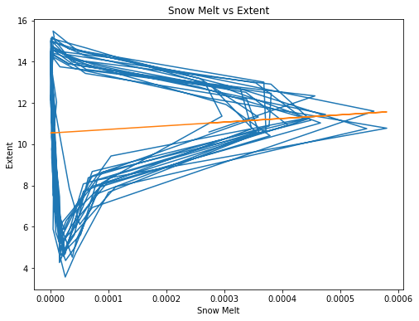
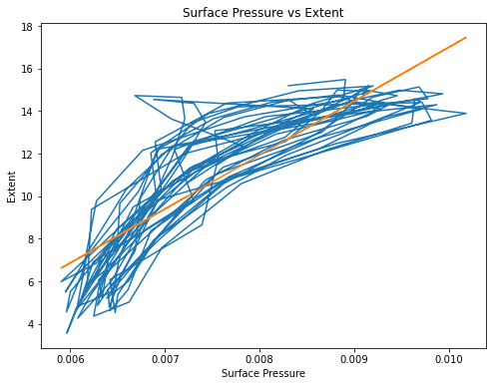
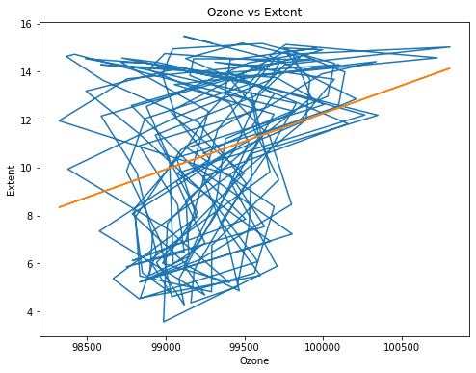
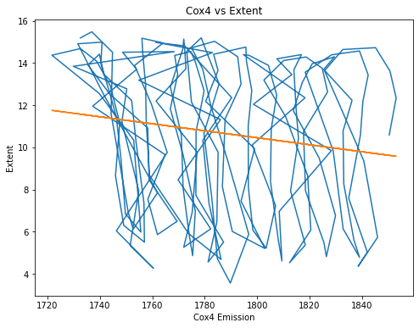
DATA EXPLORATION – Feature vs Target

Slide 9
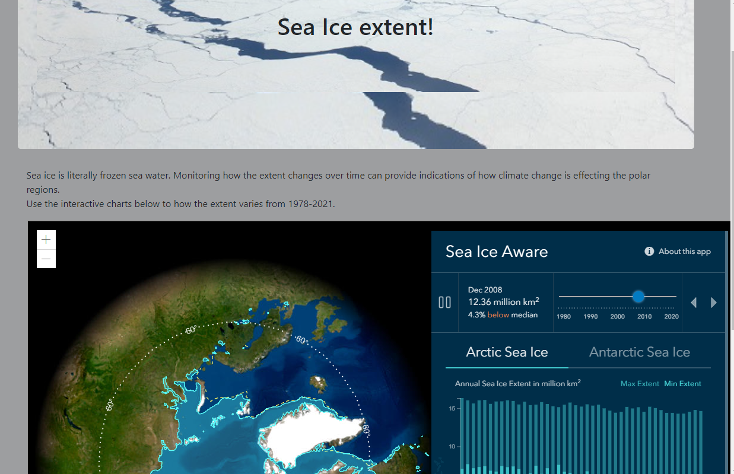
DASHBOARD BLUEPRINT
Using JavaScript and APIs to display google earth map
Github deploy
Webscrape from NASA's website to get the latest climate change news on the website
Links to other sections for team information, dataset and code

Slide 10
DATA FORECASTING
METHOD 1: using vector autoregression (VAR)
Causality testing: used granger causality test to investigate the causality between all combinations of variables in the time series
Cointegration test: to establish the presence of a statistically significant connection between two or more time series
Stationary test: augmented dickey-fuller test (ADF test) to check the stationary of each variable in the dataset. Where stationarity is not achieved, we used differencing and seasonal decomposition.
Check for serial correlation of residuals (errors) using Durbin Watson statistic

Slide 11
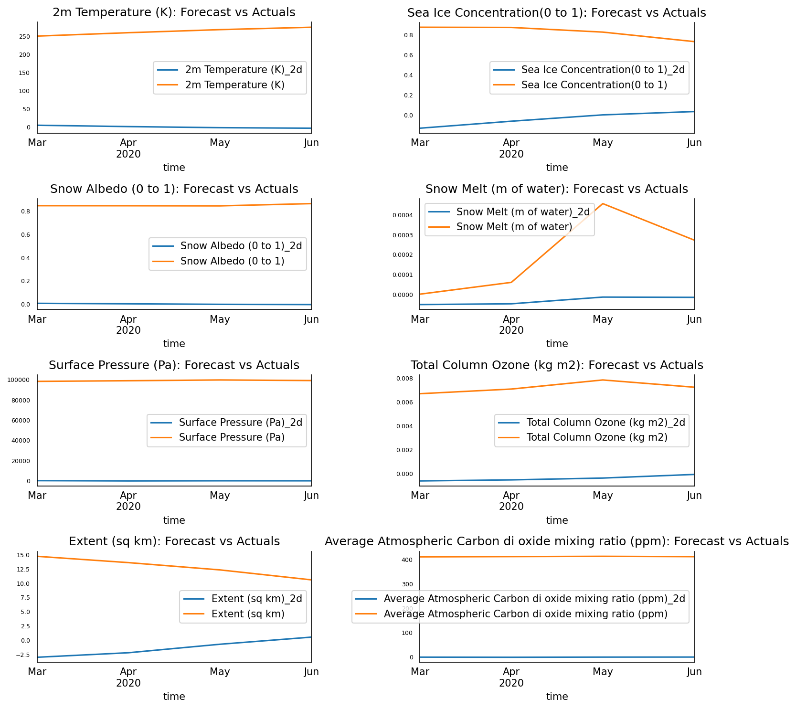
DATA FORECASTING

Slide 12
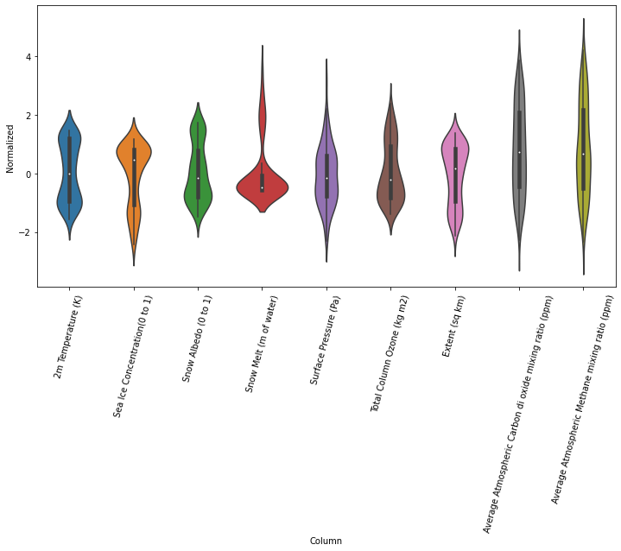
DATA FORECASTING
METHOD 2: Time-series forecasting using tensor flow, including convolutional and recurrent neural networks (CNN and RNN)
Data split and normalized(scaled) and mapped distribution of features

Slide 13
DATA FORECASTING
Data Windowing
In Progress

Slide 14
NEXT STEPS FOR SEGMENT 3 & 4
Work On Dashboard To Finalize The HTML And Deploy On Github
Scrape From NASA Climate Website
Scrape To See If Animal Extinction Can Be Incorporated
Final Results Can Be Visualized Using Tableau
Fix Machine Learning Model
Update Google Slides Based On Any Changes And Updates And Formatting

Slide 15
CHALLENGES
Data Sourcing And ETL
The Data Was Very Scientific In Nature
The Data Was Not Available In CSV, And Had To Be Converted From A NET CDF (.Nc) Format
Consistency Of Data (Uniform Dates) Across Different Time Sets
Data Pre-processing For Time Series
Time-series Was A New Concept
Limitation Of Model

Slide 16
NEW LEARNINGS
How To Use Time-series Forecasting – Tools Such As ARIMA And VAR That Incorporate Autoregression And Moving Averages
Working With non-CSV files and large data sets

